Slide 1
ITW-2 Group 14 project (HotelBoOK)
By-
Sahil Chaudhari 18074014
Manish Regar 18074009

Slide 2
Tools used
Django
Mysql
Html
CSS
Java script

Slide 3
Features
User registration through e-mail
Login page
Reset password using e-mail
Hotel search
Hotel Rooms information
Hotel booking
Hotel booking history of user

Slide 4
User registration
Account verification through via otp through e-mail
Unique username and e-mail is required
If username is already taken it will print “username taken”
Account verification through via otp through e-mail
After registration, page will redirect to login page

Slide 5
Login page
If username or password is wrong it will print “invalid credential”
For new user there is a redirect button for user registration page to create new account
Forget password button to reset password
Password reset through otp via e-mail

Slide 6
Hotel search
We can search hotel by city name and our budget
Hotels can be searched with and without login
Popular destination will appear first
We can select any hotel and see rooms information

Slide 7
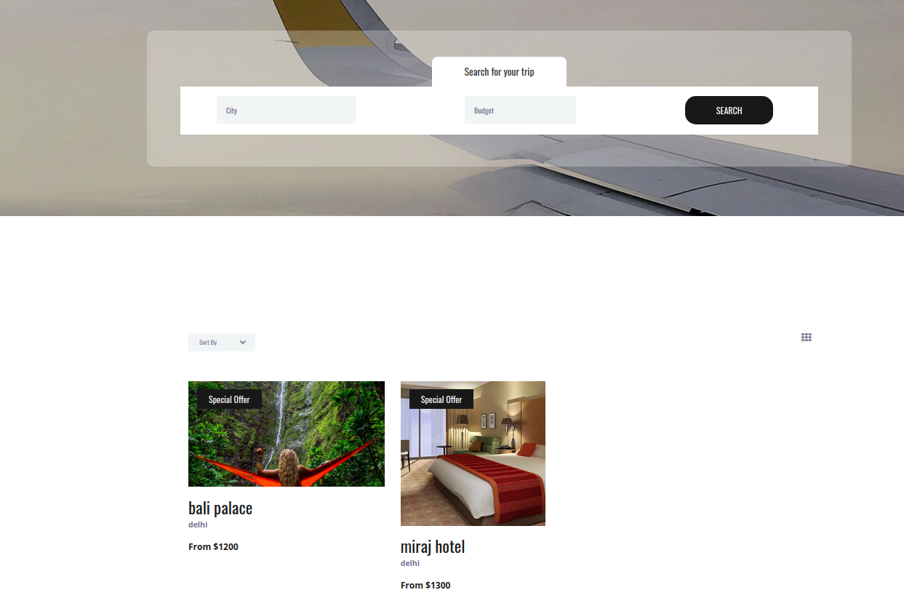
Searched hotels

Slide 8
Hotel rooms
Selection of date from which date to which date rooms are required.
Number of available rooms will be shown according to number of rooms available on selected date.
pictures of rooms are available.
Different types of rooms are available such as standard , Ac, non-AC etc.
You can also see rooms information without login.

Slide 9
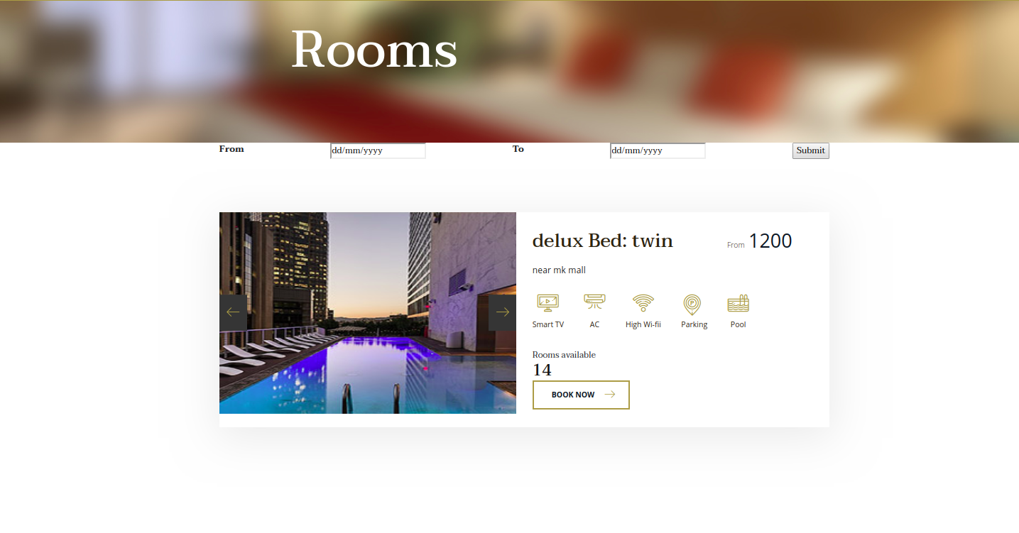
Room type

Slide 10
Hotel Booking
If you are logged in booking page will appear after selecting “BOOK NOW” option otherwise you will be redirected to login page
In booking page you can see booking summary and information such as date of booking , total price ,room type , total night of stay etc
Now you have to fill guest name and select “BOOK NOW!”
After booking cancelation option is available

Slide 11
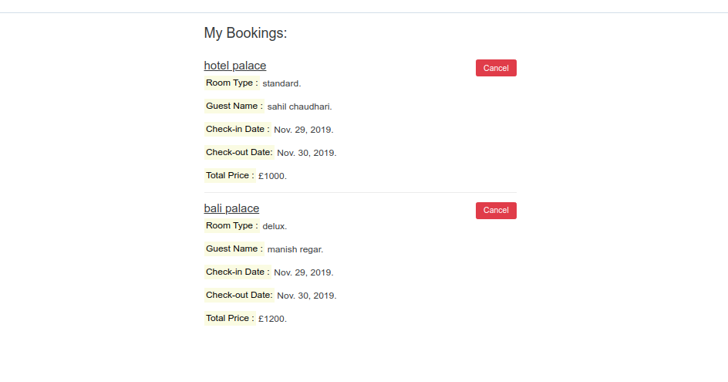
My bookings
In my booking you can see your recent bookings
you can also cancel booking whenever you want from my bookings

Slide 12
Thank you

